Slide 1
EE525 Digital Image Processing
A Single Backlit Image Enhancement Method for improvement of visibility of dark parts
Name: Abhishek Gupta
Roll No: 1901EE03
Date: 29 Nov 2022
Supervisor: Dr Rajib Jha

Slide 2
Introduction
Images acquired under backlit conditions may contain extraordinarily bright and dark areas, and the intensity difference between them may be significantly different.
General digital cameras do not have a wide dynamic range to represent scenes with vast differences between light and dark areas. The narrow dynamic range can reduce the intensity values of many pixels in dark areas, contributing to a significant loss of visibility of the subject.
This paper proposes a simple and high-speed backlit image enhancement method that effectively improves the visibility of dark areas while suppressing over-enhancement and artifacts.

Slide 3

Proposed Method
In the proposed method, the intensity image of an input color image is enhanced to create an output image.
I(rgb) is the input 24-bit RGB color backlit image and I(i, j) be the corresponding pixel at location i and j.
The intensity image is first computed using the mean of all components (red, green, blue) for a particular pixel.

Slide 4
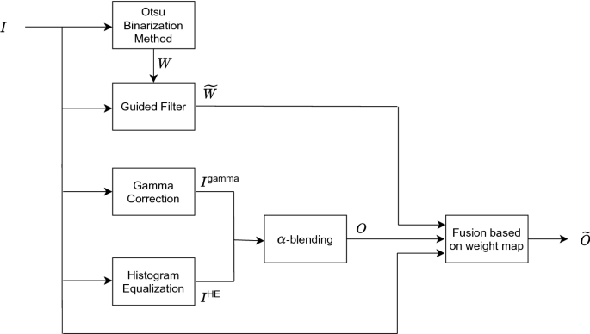
Flowchart

Slide 5
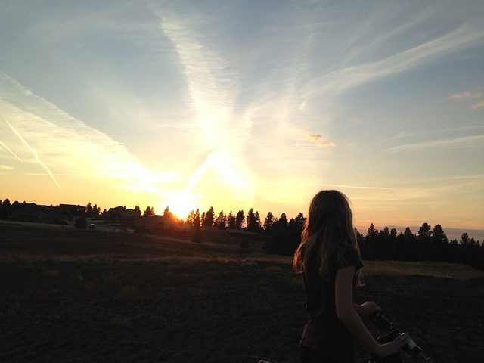
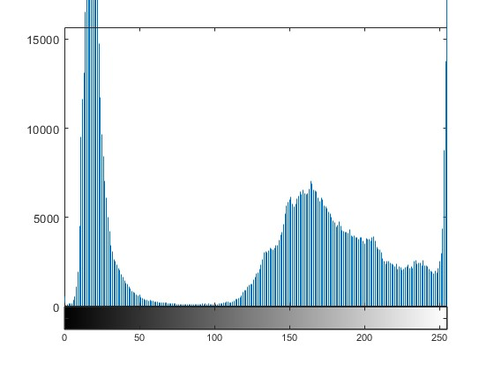
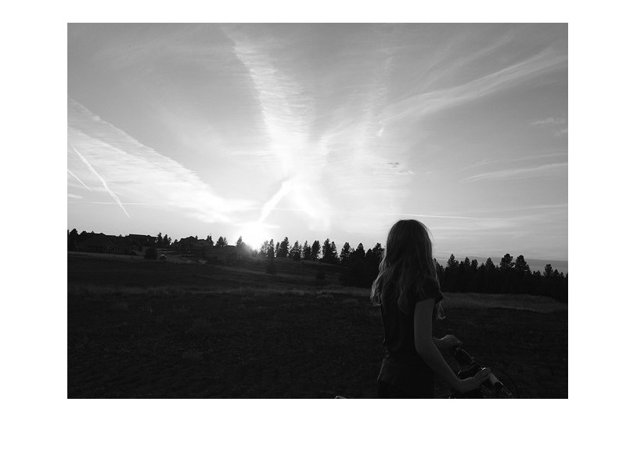
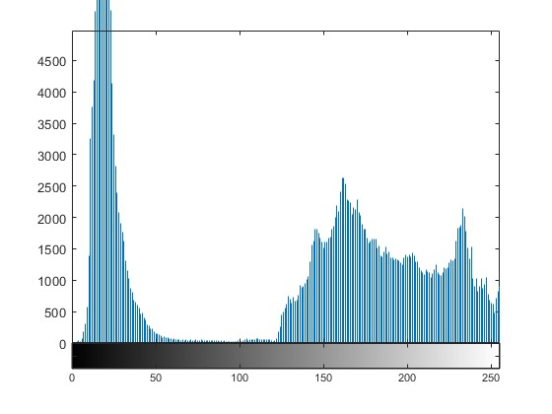
Input image and intensity image and their respective histogram

Slide 6

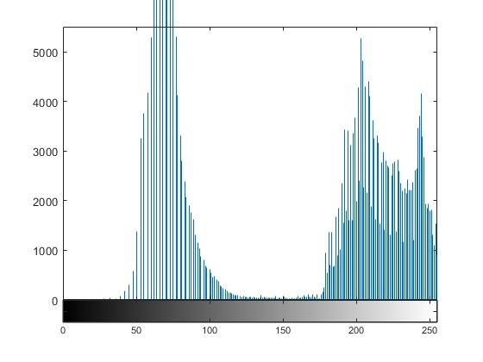
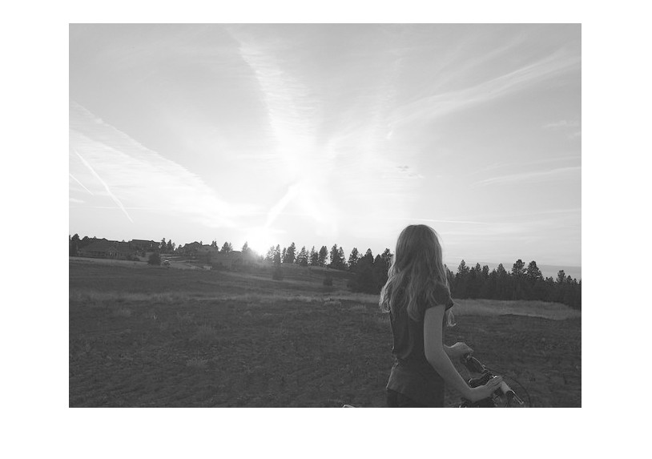
Gamma Correction
To improve the visibility of the image, gamma conversion is first applied to the intensity image
Gamma = 2

Slide 7
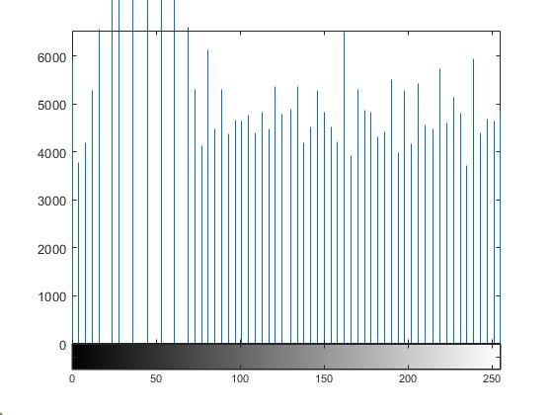
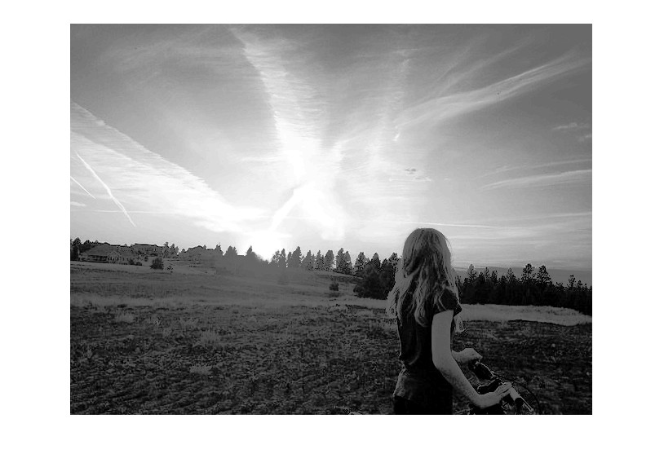
Histogram Equalization

Slide 8

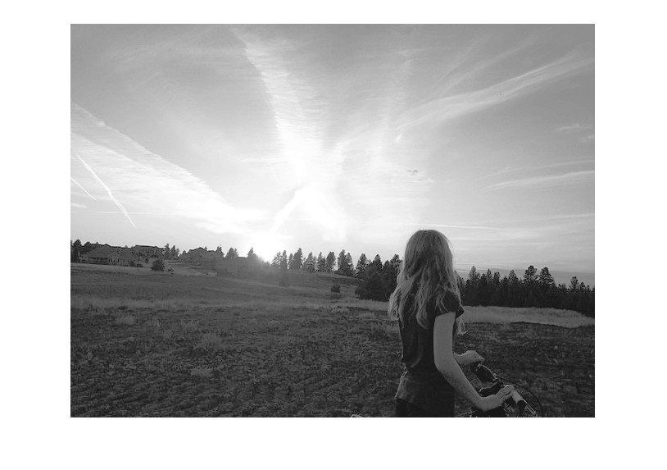
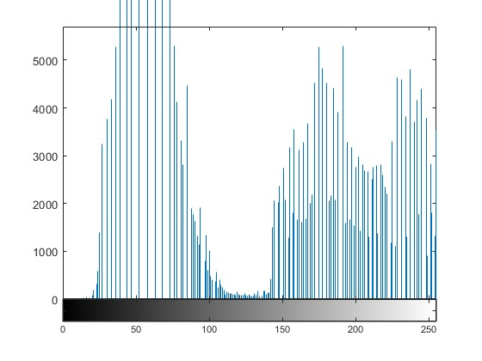
Alpha Blending
Alpha = 0.5

Slide 9
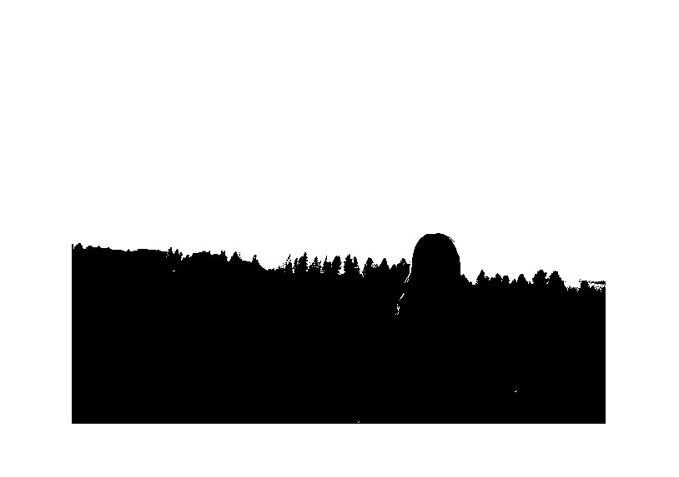

Otsu’s Method
It is a variance-based technique to find the threshold value where the weighted variance between the dark and bright pixels is the least. It is used to divide the intensity image into two classes.
Using this threshold t, a binary image W is generated.

Slide 10

Guided Filtering
Otsu’s method determines the threshold value from the histogram distribution of the entire image and does not consider the local bright-dark pattern.
To resolve this, a guided filter is applied to the weight map with I as a guide image.
The weight map smoothens while preserving the edge structure of the original image.

Slide 11

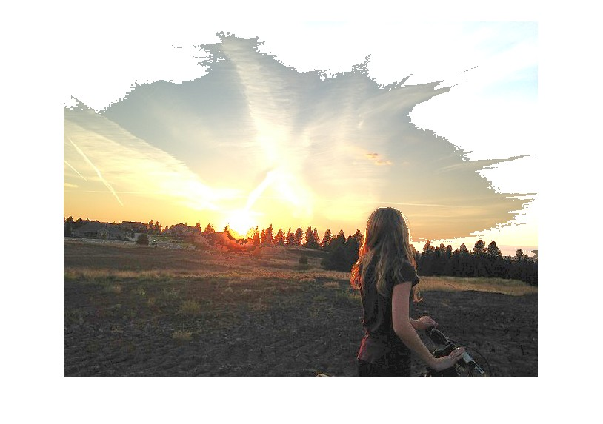

Image composition using the filtered weight map
Using the filtered weight map, the final intensity image is composed as
Then the output is colorized by using the rgb image

Slide 12
Comparison of proposed algorithm with other methods
The proposed algorithm is compared with Histogram Equalization (HE) and Contrast Limited Adaptive Histogram Equalization (CLAHE).
HE tends to improve visibility in dark parts, it may cause artifacts in bright parts. CLAHE significantly improves the visibility of the entire image.
For quantitative evaluation, Lightness Order Error (LOE) and Naturalness Image Quality Evaluator (NIQE) are used. LOE shows the change in the order of intensity between the input and output image.
NIQE is an index for calculating the non-reference image quality score. Lower LOE and NIQE values are desirable.

Slide 13
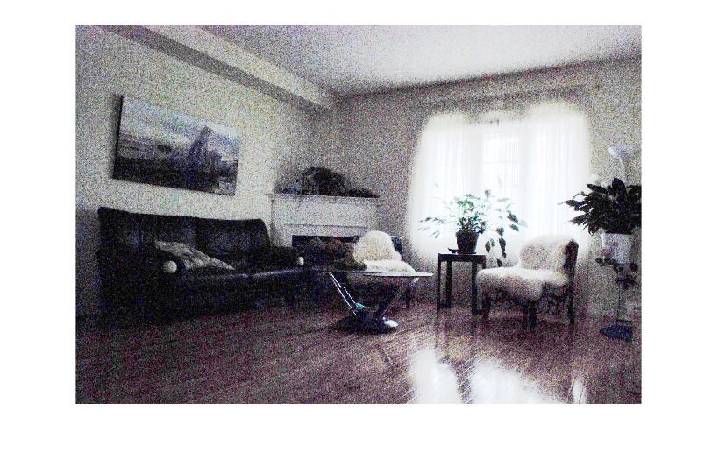
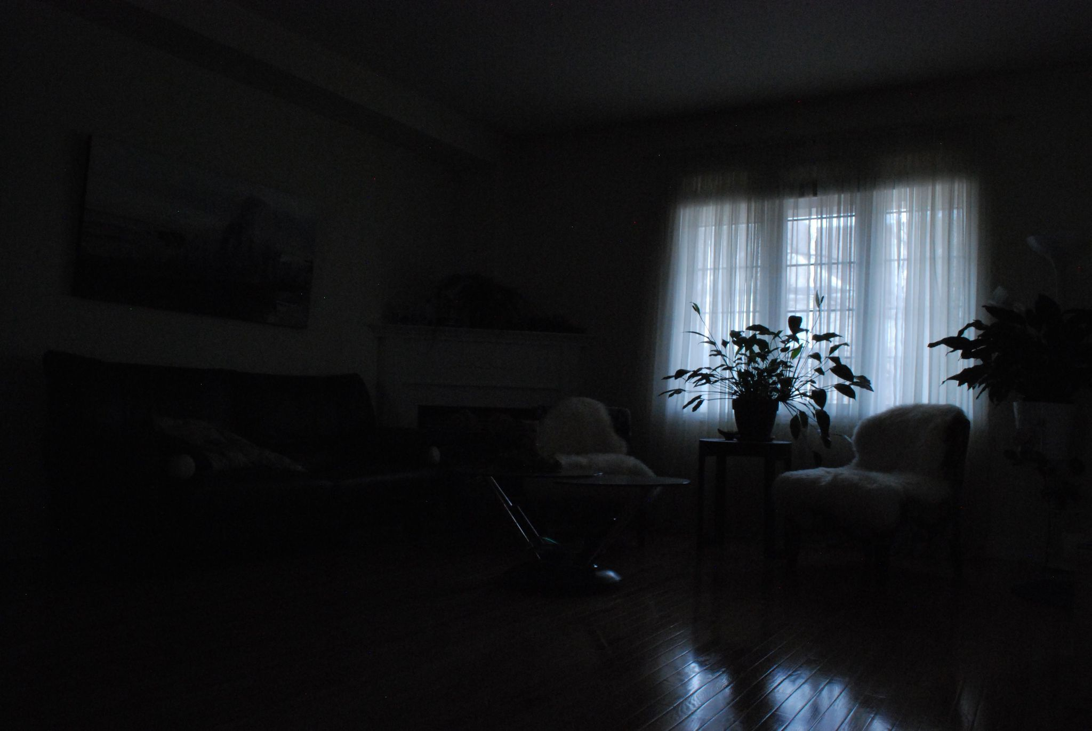
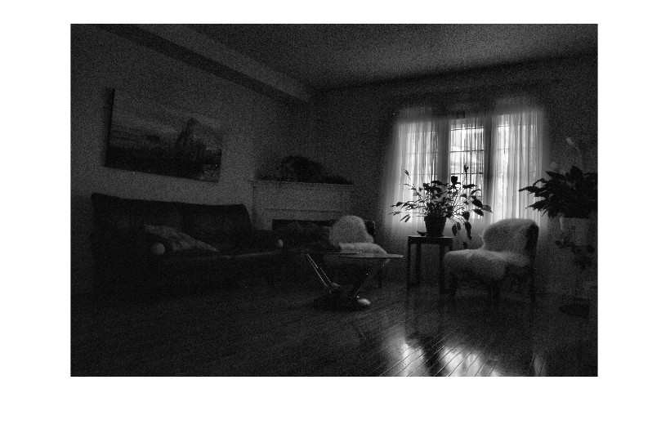
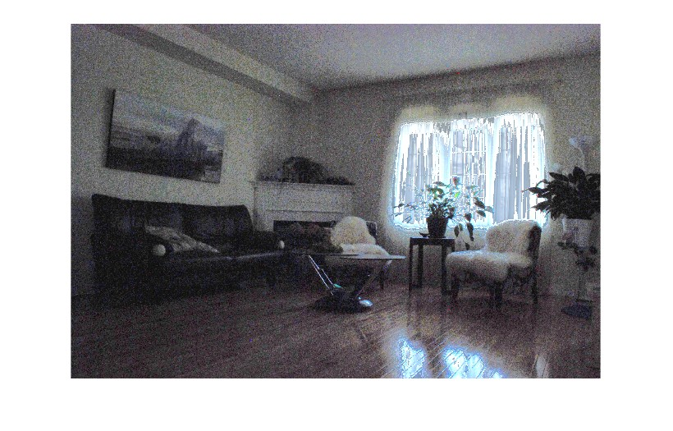
Input image
HE output
CLAHE output
Proposed method output

Slide 14

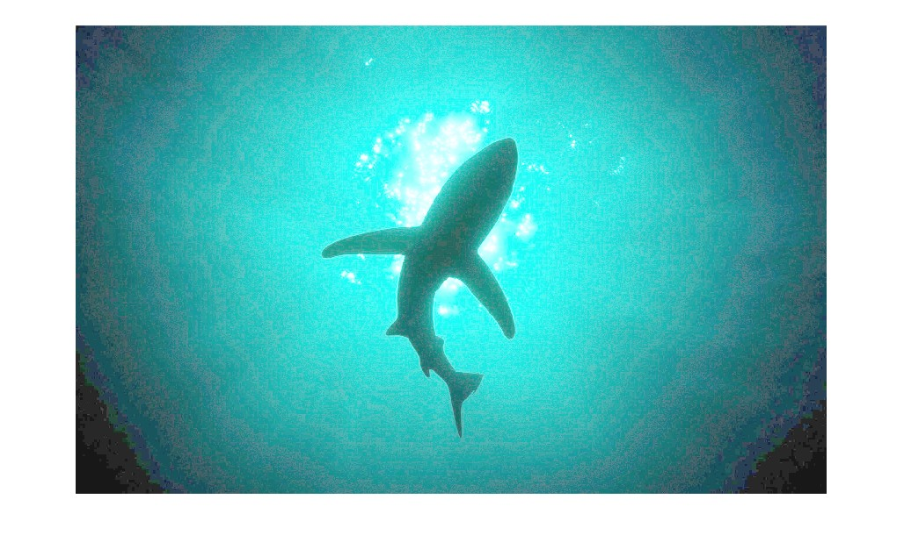
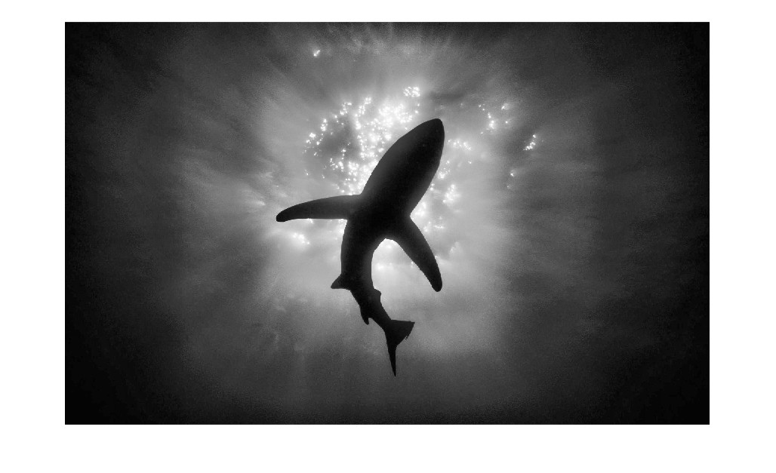
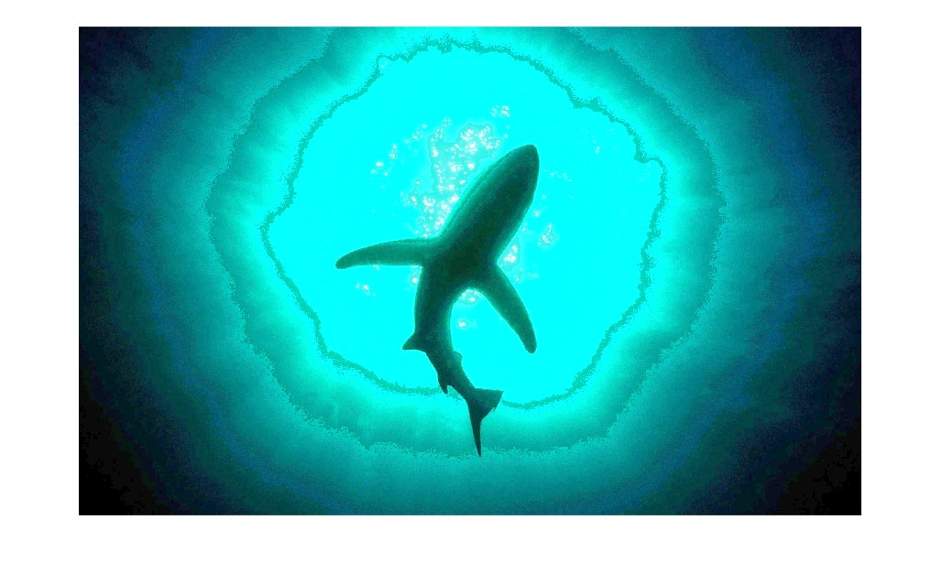
Input image
HE output
CLAHE output
Proposed method output

Slide 15
Table 1 LOE
 | Image 1 | Image 2
HE | 111.2312 | 36.3515
CLAHE | 314.8155 | 202.7883
Proposed | 106.7416 | 206.8703
Table 2 NIQE
 | Image 1 | Image 2
HE | 3.9039 | 5.2574
CLAHE | 3.2243 | 3.5248
Proposed | 3.3731 | 3.2655

Slide 16
Results
The proposed method has a better LOE score than HE, CLAHE for image 1.
For the NIQE score the method outperforms both the other methods for image 2, and nearly close to the CLAHE method for image 1.
The proposed method improves the visibility of dark parts without the appearance of artifacts.

